Slide 1

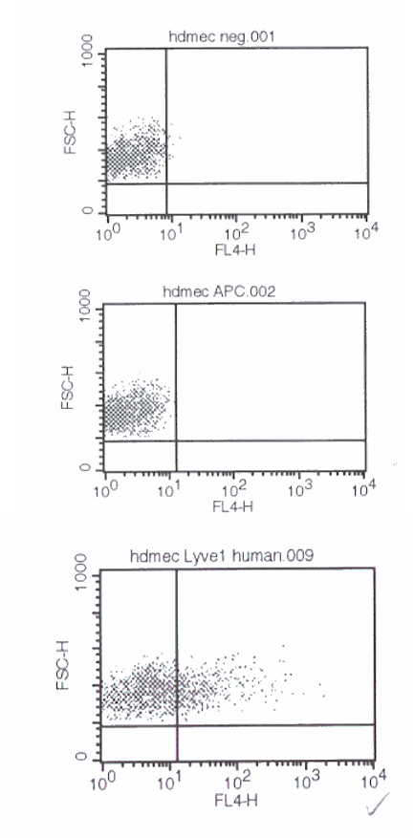
ReliaTech GmbH
Rabbit anti-human LYVE-1
(Cat #102-PABi50)
Fig. 1: FACS analysis with primary human dermal lymphatic endothelial cells (HDLEC) using a Biotin-conjugated rabbit anti-human LYVE-1 antibody.
http://www.reliatech.de / orders@reliatech.de

